Slide 1
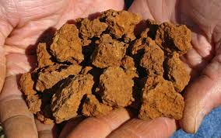
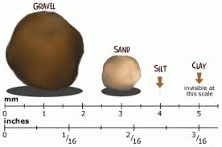
AS 1726:2017
Geotechnical Site Investigations
Michael Gawn – Principal (Newcastle)

Slide 2
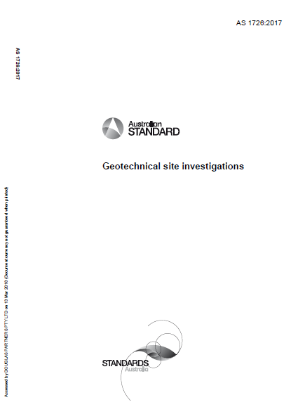
New Standard

Slide 3
AS 1726:2017 Geotechnical Site Investigations
Contents of Presentation
  So What’s Different
  Changes to DP Logging
  Review of Universal Classification System
  Rock Logging
  Additional Logging Changes
  Implications for Reporting
  Other important changes to AS1726
  Useful Spreadsheets for Logging
  Take Home Message

Slide 4
So what’s different?
Previous revision 1993
Previously the delineation between a coarse material (sand,gravel) and a fine material (clay, silt) was based on the majority rule (ie. If more than 50% above 75 micron = coarse soil)
Now new boundaries, as follows
  >65% above 75 micron Sand or gravel
  >35% below 75 micron Clay or silt
  Why? It only takes a relatively small amount of fines to alter the behaviour of the soil

Slide 5
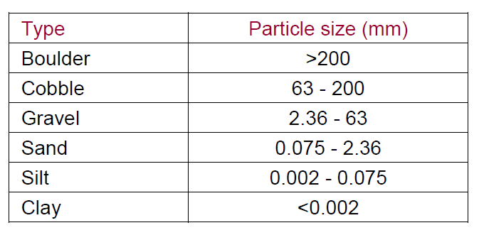
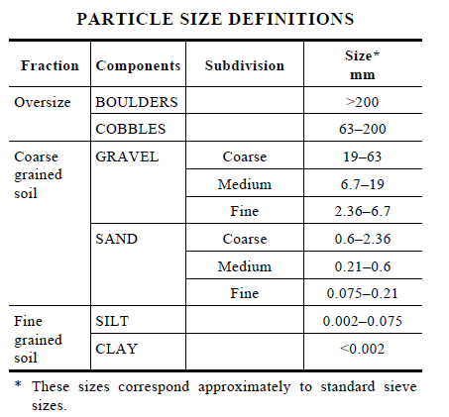
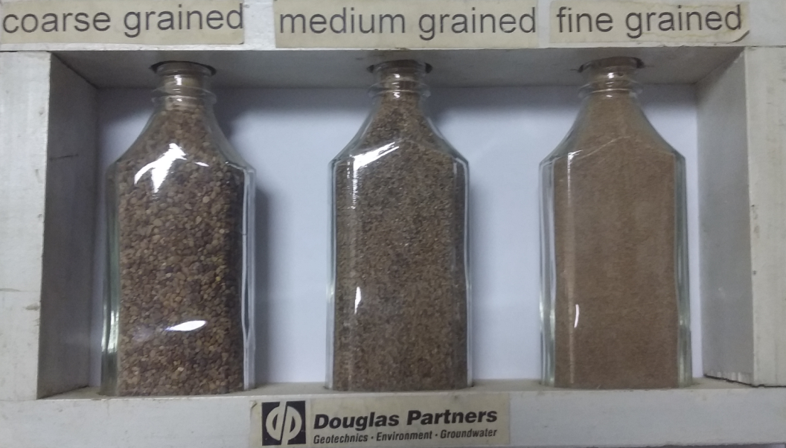
How does this differ from DP Logging?
No difference to boundaries from previously but slight difference to subdivision for sand
DP Notes
AS 1726:2017

Slide 6
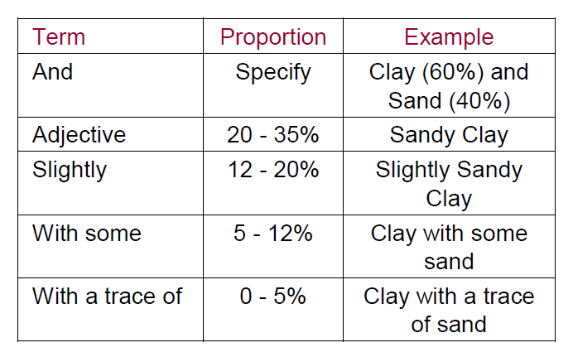
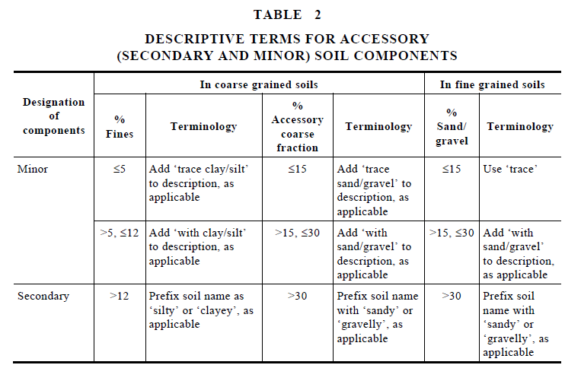
Secondary Constituents and Naming
AS 1726:2017
DP Notes
Different thresholds for terminology
DP notes being changed to reflect new code

Slide 7
Secondary Constituents and Naming
Previously a soil would become “clayey sand“ for instance with 20% to 35% clay. Now only 12% clay is required to be a “clayey sand”
Now if a soil has greater than 35% fines it is a fine soil
  Therefore, a soil with 64% sand and 36% clay is a sandy CLAY not a clayey SAND.
  This is to try to convey the behaviour of the soil (i.e that amount of clay is going to make it behave like a clay).

Slide 8
Secondary Constituents and Naming
Note: Different thresholds for secondary constituents in coarse as opposed to fine soils.
This reflects that it takes a lot more coarse material to change the behaviour of the soil (30% v 12%).

Slide 9
Minor Soil Components
Terms used is as follows:
Trace (<5% fines) or (<15% coarse)
With (>5% to 12% fines) or (>15% to 30% coarse)
Adjective modifier (eg sandy)
  (>12% fines) or (>30% coarse)
        No use of “slightly” or “some”

Slide 10
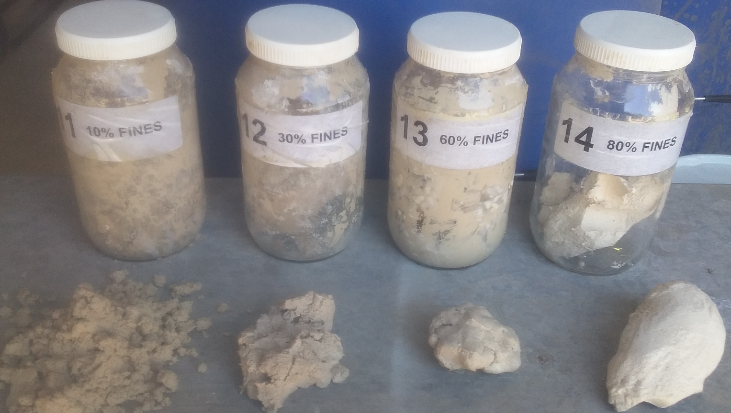
Examples of Soils
Examples of different soils
  Sample 11 Sand with clay
  Sample 12 Sandy CLAY
  Sample 13 Sandy CLAY with silt
  Sample 14 CLAY with sand
10% fines
35% fines
60% fines
80% fines
SAND with clay
Sandy CLAY
Sandy CLAY
CLAY with sand
Bore/ Pit | %Silt and clay | %Clay | %silt | %Sand | %Gravel |  | Description to AS1726:2017 | Classification
Sample 11 | 10% | 10% | 0% | 90% | 0% |  | SAND with clay | SP/SC
Sample 12 | 35% | 35% | 0% | 65% | 0% |  | Sandy CLAY | CL,CI or CH
Sample 13 | 60% | 50% | 10% | 40% | 0% |  | Sandy Clay with silt | CL,CI or CH -see note 2
Sample 14 | 80% | 80% | 0% | 20% | 0% |  | CLAY with sand | CL, CI, CH, ML or MH

Slide 11
Naming
Primary Component in BLOCK LETTERS
Secondary component included in name if over secondary threshold
Minor components added after name
  Eg Clayey SAND with trace gravel

Slide 12
Determining Fine Content
If hydrometers done then use them
If Atterberg done use the following rule
  Above A line clay
  Below A line silt
If neither done then use tactile assessment for clay/silt – use water!

Slide 13
Plasticity
Terms
  Non plastic
  Low plasticity
  Medium plasticity
  High plasticity
  Note: Medium not Intermediate

Slide 14
Moisture Condition
Coarse Soils
  Only three terms used, as follows:
    Dry
    Moist
    Wet
  No use of “humid” or “saturated”
Fine Soils
  Moist, dry of plastic limit (w<PL)
  Moist, near plastic limit (w≈PL)
  Moist, wet of plastic limit (w>PL)
  Wet, near liquid limit (w ≈LL)
  Wet, wet of liquid limit (w>LL)
Use textural test in the field (i.e roll a 7 mm long thread)
DP will use description in brackets only

Slide 15
Group Symbol Classifications
Two characters system
Primary Classifier (i.e. first letter)
  (G,S,M or C for Gravel, Sand, Silt or Clay)
Secondary Classifier (i.e. second letter)
  (Coarse Soils)
    Reflect grading (W or P for well or poorly graded)
    Or Fine content (C, M or O for clay, silt or organic)
Secondary Classifier (i.e. second letter)
  (Fine Soils)
    Reflect plasticity (L, I or H for low, intermediate or high)
    Note silt only uses L or H (no I)

Slide 16
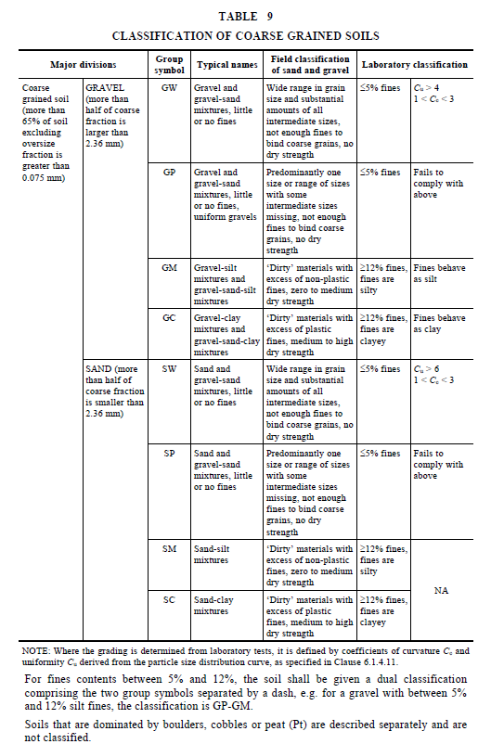
Classifications
Coarse Soils
Gravel Dominated Soils
GW – well graded gravel
GP – poorly graded gravel
GM – gravel-silt mixture
GC – gravel-clay mixture
Sand Dominated Soils
SW – well graded sand
SP – poorly graded sand
SM – sand-silt mixture
SC – sand-clay mixture
Note: Fines contents between 5% and 12% to have dual classification – eg GP-GM

Slide 17
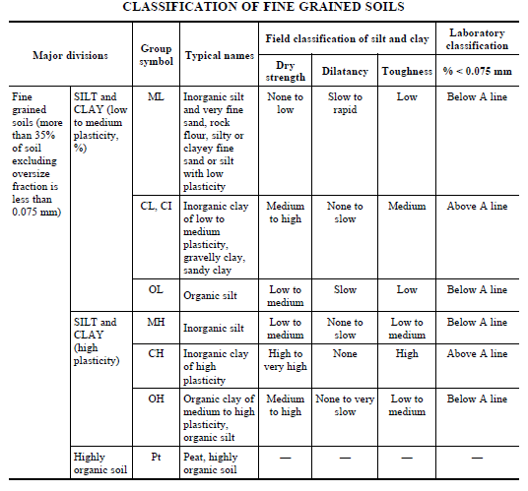
Classifications
Fine Soils
Silt Dominated Soils
ML – low plasticity silt
MH – high plasticity silt
OH – organic silt
Clay Dominated Soils
CL – low plasticity clay
CI – medium plasticity clay
CH – high plasticity clay
OH – organic clay of medium to high plasticity
Pt – peat

Slide 18
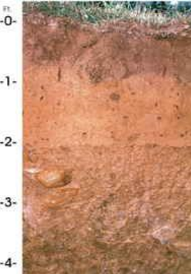
Rock Classification
Changes in strength characterisation
  Removal of extremely low strength
  Material with a strength less than very low should be described as a soil but any rock structure noted.
  UCS categories included (using a ratio of 20:1 with point load index)
Classification Symbols – same as used by DP (without EL)

Slide 19
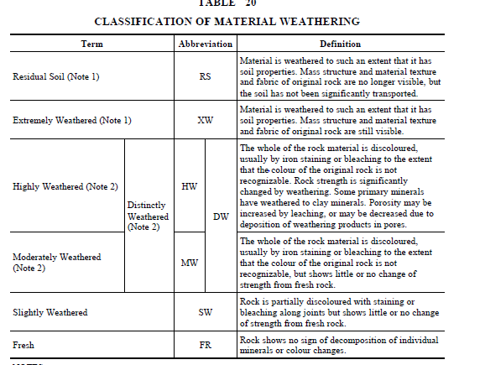
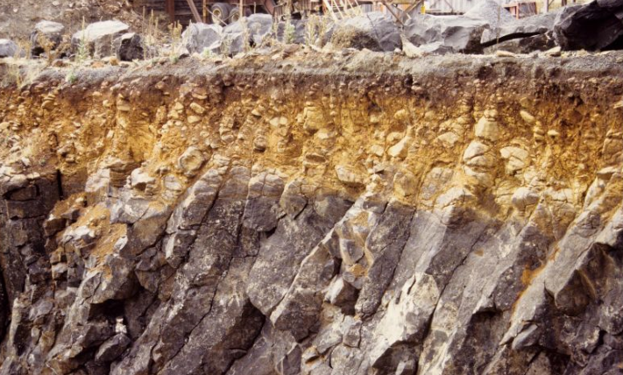
Rock Weathering
XW?
SW?
REMEMBER: RMS (NSW) has its own weathering classification system

Slide 20
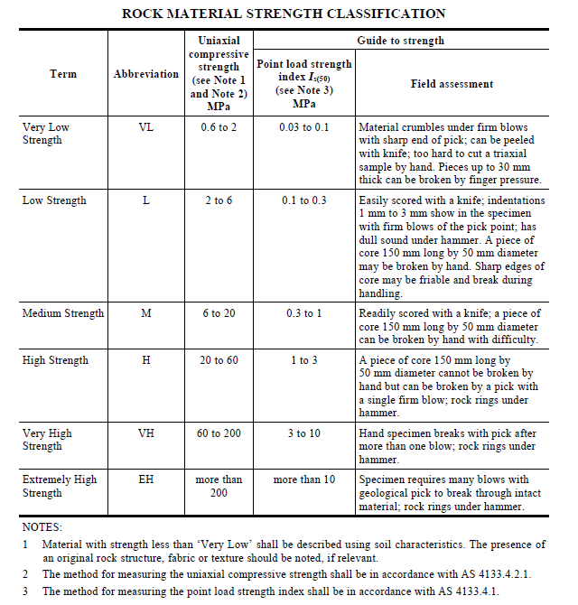
Rock Strength
No longer Extremely low strength rock
Now includes UCS ranges
Material with strength less than “Very Low” shall be described using soil characteristics. The presence of the original rock structure, fabric or texture should be noted, if relevant

Slide 21
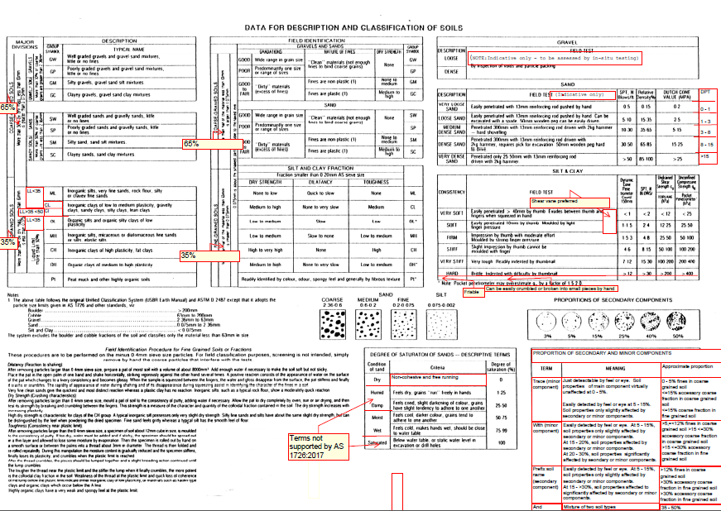
Additional Logging Changes
DP carried out extensive review of AS1726 (Grahame Wilson), with changes to DP procedures agreed to by Board
DP review of Field Procedures Manual (to be released soon)
  Part A – Introduction and Fundamentals (principles of soil/rock behaviour)
  Part B – Collection (how we record data)
  Part C – Data Entry (gINT, DigiPen)
  Part D – Presentation (how data is to be presented)
Log templates being amended (to suit new code and digipen usage)
  No longer double up of strength graphic and description
  Changes to descriptors (pale rather than light)
  Main soil type in uppercase, not both (eg clayey SAND)
Soil origin is required to be interpreted. If in doubt use ‘possibly’ or ‘probably’
Code gives examples of soil description
  (SP Sand, trace silt, grey, medium grained, medium dense; dry; marine; Tomago Sand Beds)

Slide 22
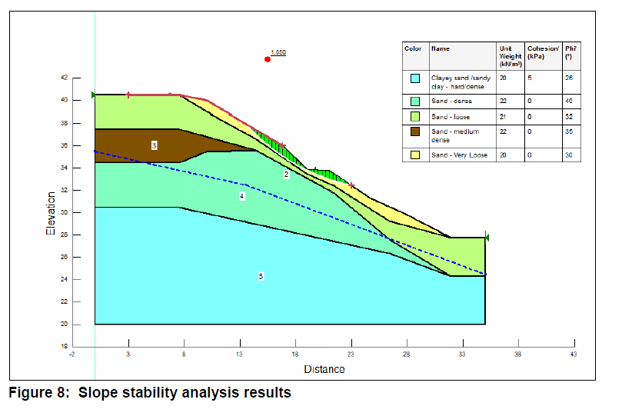
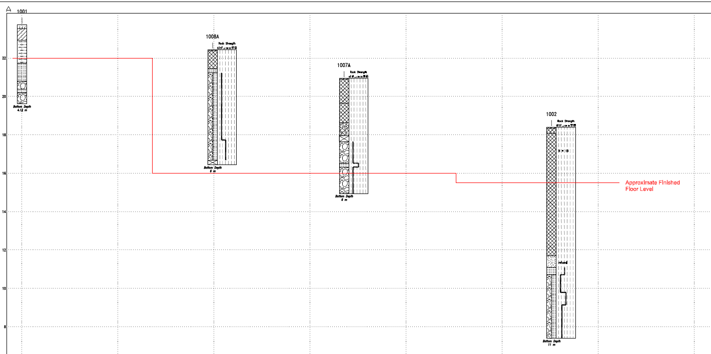
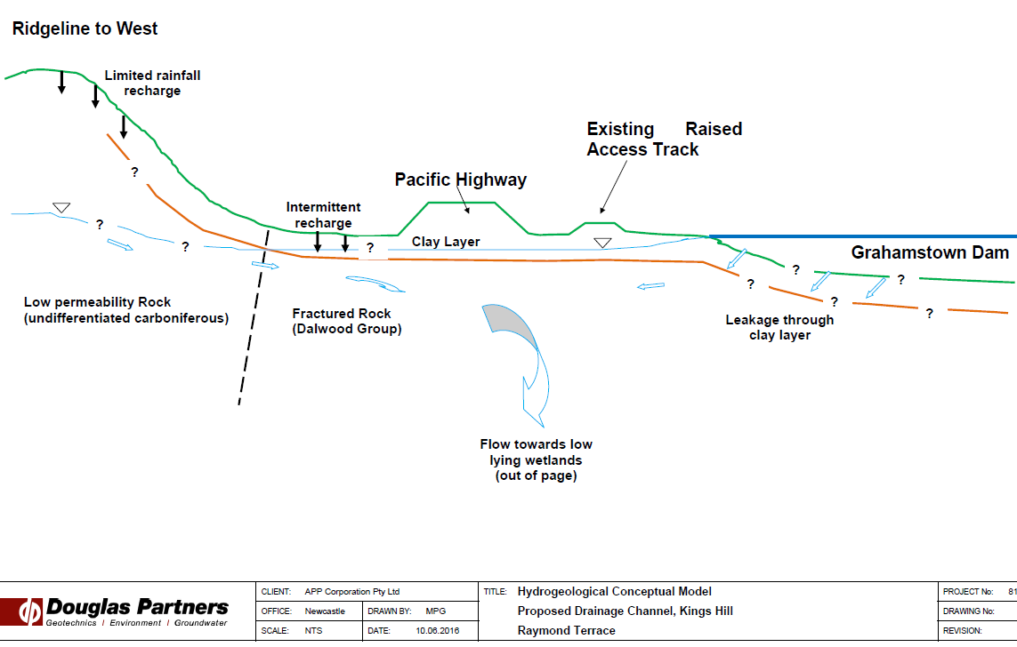
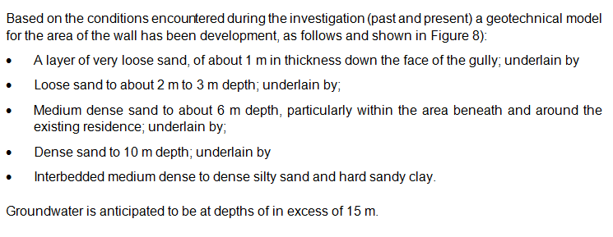
Reporting Implications
Literature review required (ie. Previous projects, published mapping, etc)
Don’t forget historical aerial photos and 1974 Orthophotos – excellent resource
Code requires that a ‘geotechnical model shall be developed for every geotechnical site investigation’

Slide 23
Other Changes
New Code has a whole section of material alteration (extremely, highly, moderately and slightly) with abbreviations. This is based on visual assessment
It has good guidance on description of defects
  Situation by situation. Some circumstances it is important to describe each joint/defect (ie. Unfavourable joints in excavation face)
  Other circumstances generalisation of defects may be better to provide geotechnical model (eg foundation design)
  Terms such as “joint spacing is typically 100 mm to 300mm and most joints traces less than 100 mm”

Slide 24
Other Changes
Has a more geological approach to jointing with good descriptions around dip, dip direction and strike
Roughness (with roughness counts, waviness, etc)

Slide 25
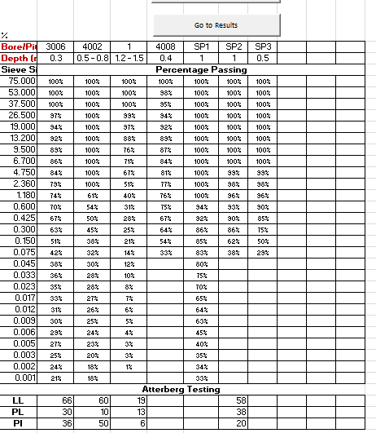

Soil Classification Spreadsheet
Enter details and copy percentage passing from lab results
Enter Atteberg results, if any

Slide 26
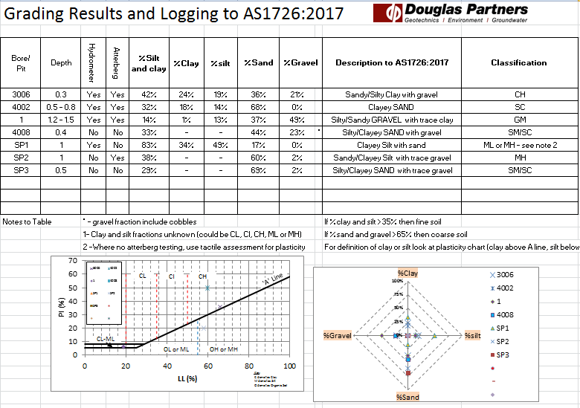
Soil Classification Spreadsheet
Presents data with comments on lab testing
Provides Soil portions
Give soil description and Unified Soil Classification
Grading proportions
Plasticity Curve

Slide 27
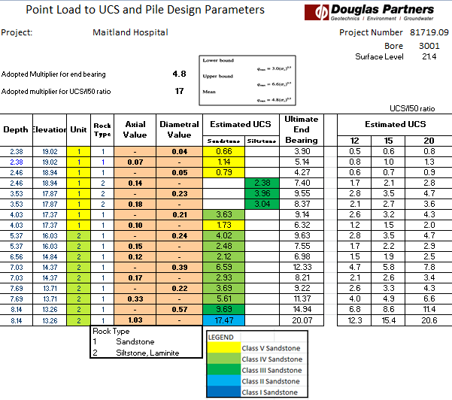
Enter UCS/PL ratio and adopted multiplier (guidance in box)
Input depth, Unit, Rock Type and PL values
Provide range of estimated UCS based on common ratios
Calculates estimated UCS and ultimate end bearing
Colour codes rock class (based on Pells et al) and using strength only – must consider defects/seams

Slide 28
Take Home Message
It doesn’t take a lot of fines to make a soil “fine grained”. This reflects soil behaviour
Extremely low strength rock should be logged as soil or ‘extremely weathered (name of parent rock)’
Pay attention to gradings and PIs (roll threads in field – take spray bottle)
DP logging sheets and DP Field Procedure Log section of Company Manual being changed (out soon)
New Code is a good recourse for Geo/Env Engineers

Slide 29
That’s all!
Thanks to the following people who are driving and assisting in the innovations to our procedures:
Grahame Wilson
Will Wright
Tim Swavley
Heidi Sirianni

