Slide 1
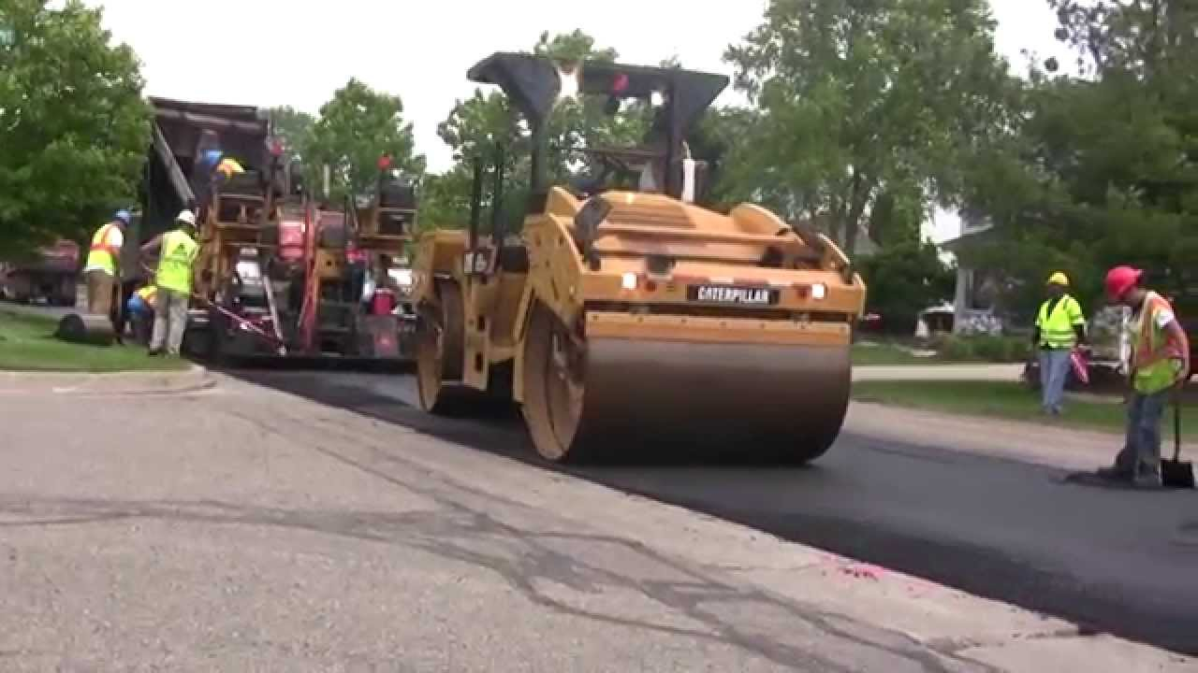
Pavement Overlay Design
Michael Gawn – Principal (Newcastle)

Slide 2
Why Overlay?
Cheaper than reconstruction
Suitable for shorter life span (asset prioritisation)
Faster than reconstruction/stabilisation

Slide 3
Types Of Overlay
Several types:
Granular Ranging from 50 mm to 200 mm or so, pavement material (can be stabilised)
Asphalt Ranging from 40 mm to 100 mm or so, asphalt (can be several layers). Can be thin or deep lift
Concrete Mainly over existing rigid pavements (stitched in)

Slide 4
Types Of Overlay
Limits:
Granular overlays up to 10⁸ ESA
Asphalt overlays up to 10⁷ ESA

Slide 5
Basis for Overlay Design
Based on pavement deflections (and curvature)
Need to ensure sufficient existing structural thickness
Improving road structure to allow it to satisfy increased traffic load (i.e. life)
Remember drainage is an important consideration

Slide 6
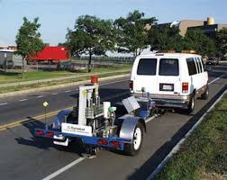
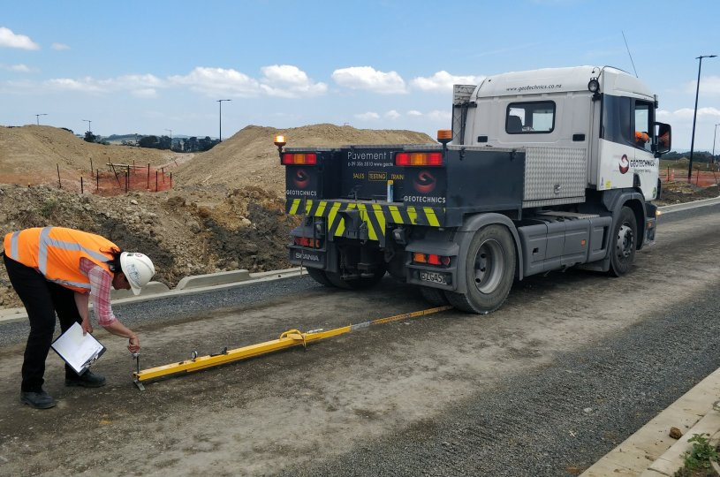
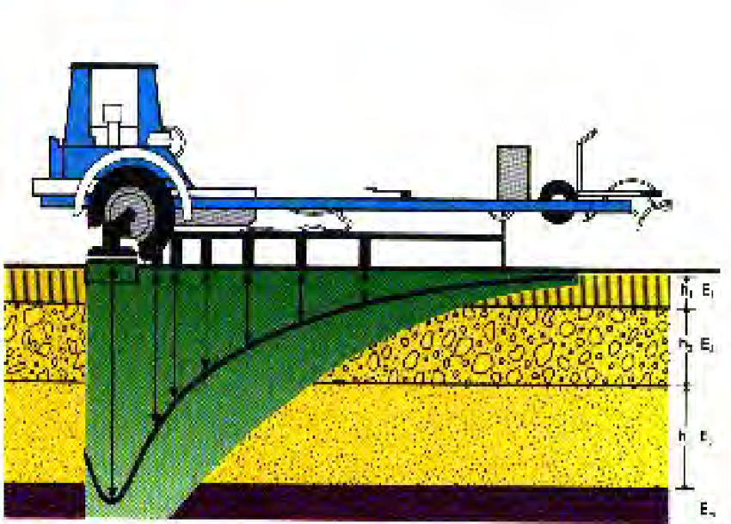
Data Collection
Deflection testing of road
  Benkelman beam
  Falling weight deflectometer (40 kN)
  Deflectometer

Slide 7
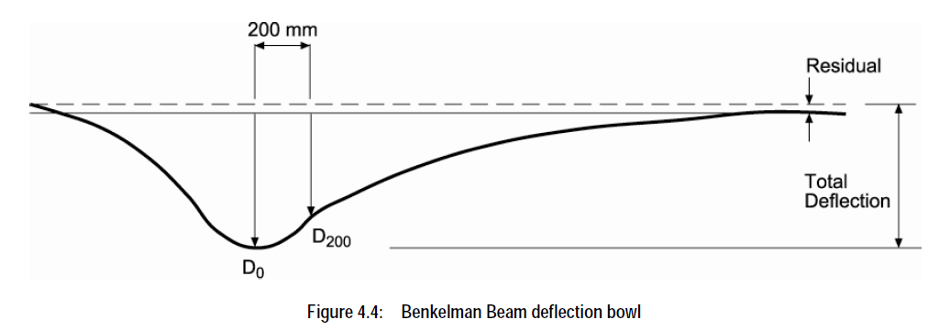
Data Collection
Curvature = D200 – D0
Beaming
  Take readings regularly (say 10 m to 20 m in both wheel paths)
  Alternating wheel paths is usually undertaken
  Record rebound deflections at:
    200 mm
    600 mm
    900 mm
    2700 mm
    9000 mm
  Very important to take pavement temperature

Slide 8
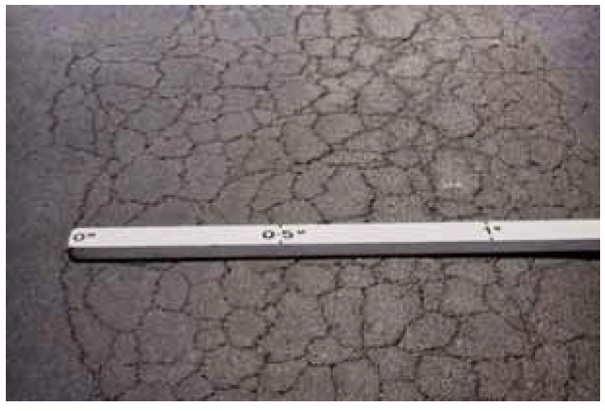
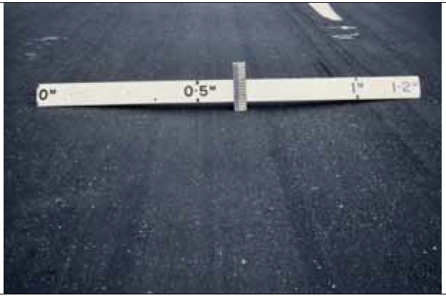
Data Collection
Pavement Condition
  Inspect pavement for defects:
    Rutting (can be indicator of subgrade failure)
    Shoving (subgrade failure or poor gravel)
    Cracking (cemented material?)
    Edge break (thinning on edge?)
  Austroads Guide to Visual Assessment of Pavement Condition
    Draw maps
    Extent of damage
    Type of damage
    Drainage conditions!!!
    In-ground service trenches

Slide 9
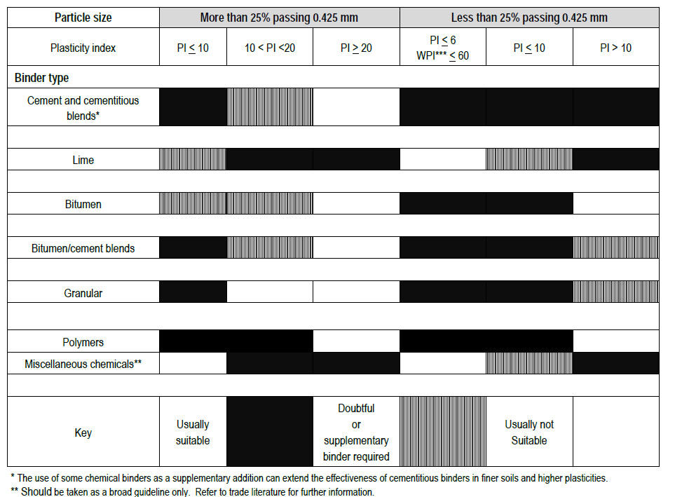
Overlay Design - Types
  Heavy Patching
    Can be used to correct short sections where full reconstruction is not economical
    Where finish level constrained (i.e. kerb and gutter)
  In-situ Stabilisation (incorporating existing)
    Improve conditions where existing gravels have high plasticity
    Allows thinner increase in pavement thickness
    Re-uses some existing material
  Granular Overlay
    Can be cheaper than AC
    Use where levels not constrained
  Asphalt Overlay
    Thinner than granular
    Greater structural improvement

Slide 10
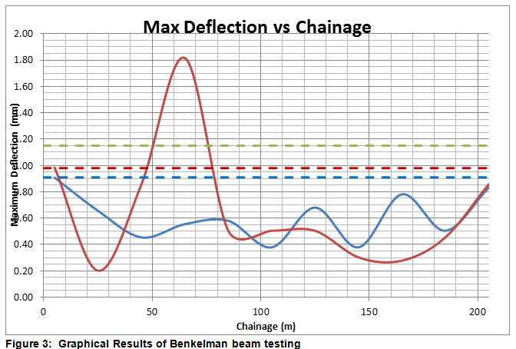
Overlay Design Procedure
Segment Pavement into areas of similar deflection performance
  Based on coefficient of variation (CV)
  CV = Standard Deviation / Mean (of deflection results)
  Segments should ideally by greater than 100 m
One outlier result – service trench?
Design Deflection – what deflection needs to be to cope with projected traffic
Remove result (heavy patch) and remaining road meets deflection criteria

Slide 11

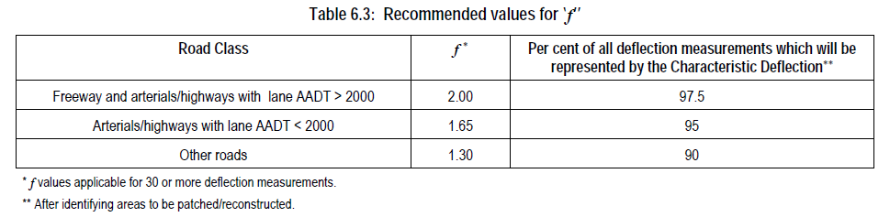
Overlay Design Procedure
Characteristic Deflection
  Indicator of overall performance of pavement segment:
    µ = mean of deflection readings
    f = factor for road function (how busy the road is)
Where <30 readings, max deflection can be better

Slide 12
Overlay Design Procedure
Characteristic Curvature
  Mean of curvature results in segment
Curvature = D200 – D0

Slide 13
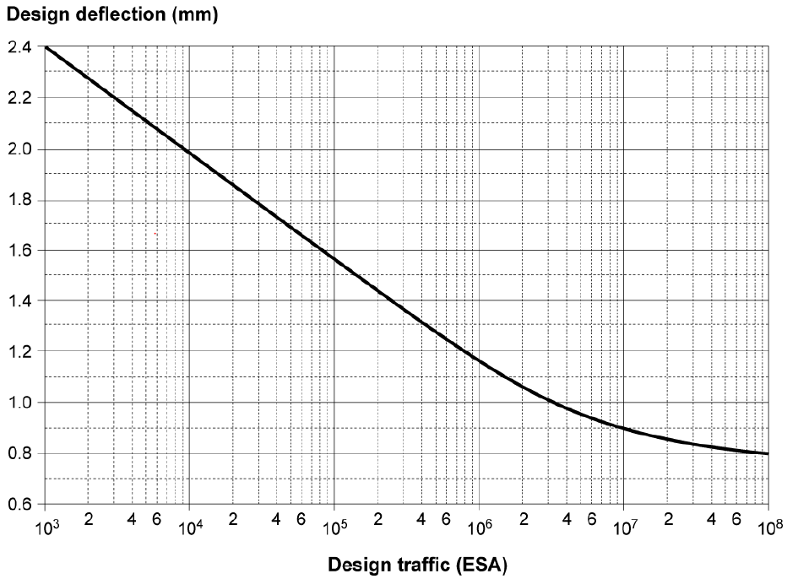
Overlay Design Procedure
Determine design deflection from design traffic
Example: For 10⁶ ESA design deflection is 1.18 mm

Slide 14
Overlay Design Procedure
Adjust deflection data for
  Method of collection
  Seasonal variation
  Pavement temperature

Slide 15
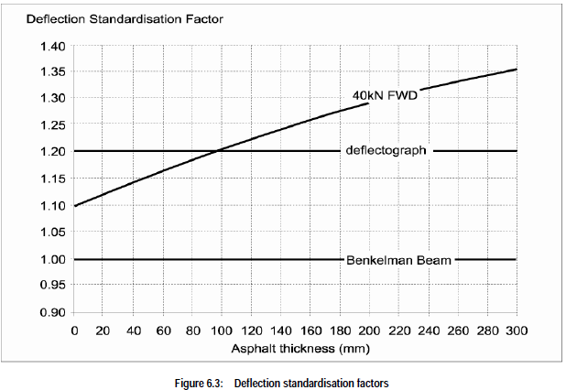
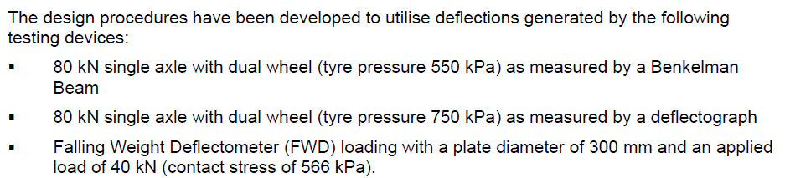
Deflection Standardisation Factor - Method

Slide 16
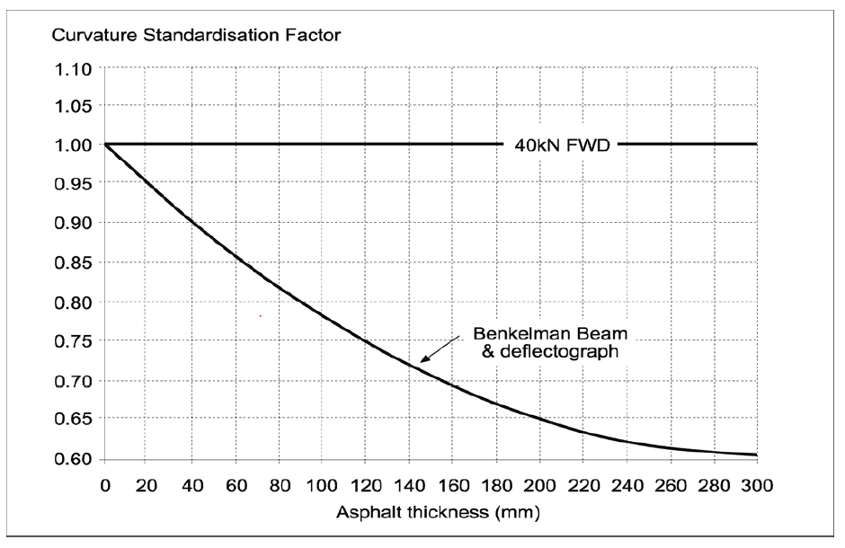
Deflection Standardisation Factor - Method

Slide 17
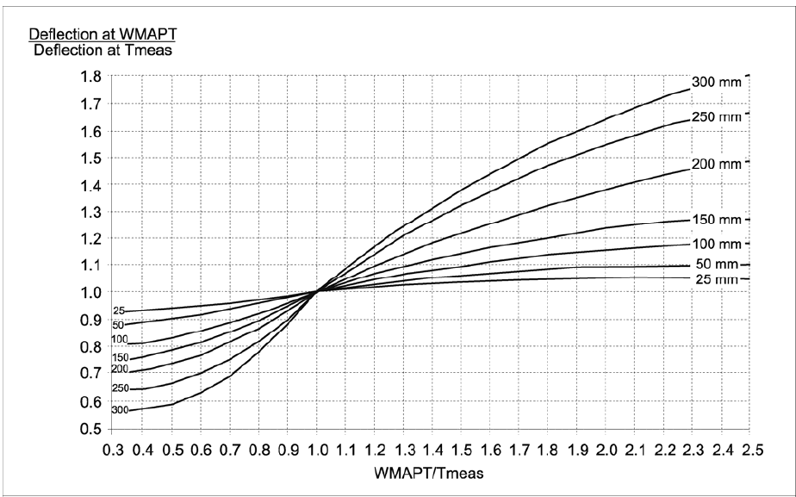
Deflection Standardisation Factor - Temperature
WMAPT = mean weighted average pavement temperature – See Austroads
Tmeas = temperature at time of testing
As AC gets thinner correction gets smaller
NOTE: Different graphs for Benkelman beam v FWD
Also correction curve for curvature
No correction needed for <25 mm AC

Slide 18
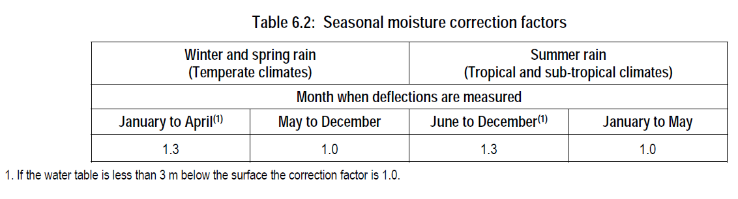
Deflection Standardisation Factor - Season
Correction for time / season of testing
Applied to deflection and curvature
Note for silt subgrades could be much greater

Slide 19
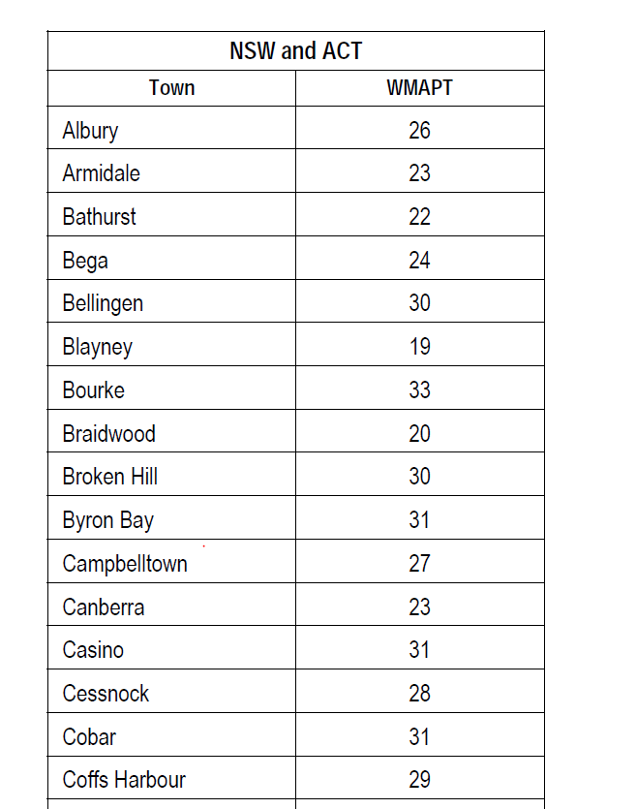
Design Procedure – Example
We have determined parameters
  Characteristic deflection = 1.2 mm
  Done in November with Benkelman Beam
  AC thickness 40 mm
  Pavement Temperature = 36 degrees
  Going to mill off 25 mm of AC
  Adjust for temperature WMAPT/Tmeas = 1.3

Slide 20
Design Procedure – Example
  Adjust for temperature WMAPT/Tmeas = 1.3 and therefore adjustment factor of 1.05
  Seasonal factor (temperate climate in Nov) therefore 1.0
Asphalt thickness
1.05

Slide 21
Design Procedure – Example
  Seasonal factor (temperate climate in Nov) therefore 1.0
Most cases

Slide 22
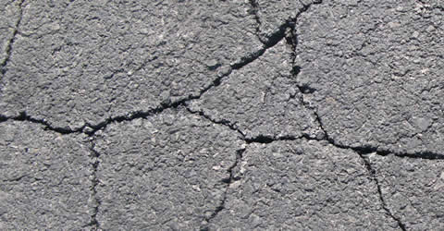
Design Procedure – Example
We have determined parameters
  Characteristic deflection = 1.2 mm
  Done in November with Benkelman Beam
  AC thickness 40 mm
  Pavement Temperature = 35 degrees
  Possibly going to mill off 25 mm of AC
  Kerb and Guttering
  Corrected CD = 1.58 mm
  Corrected CC = 0.33 mm
  For milling depths of up to 50 mm, increase CD and CC by 15% to 25% for each 25 mm of asphalt milled

Slide 23
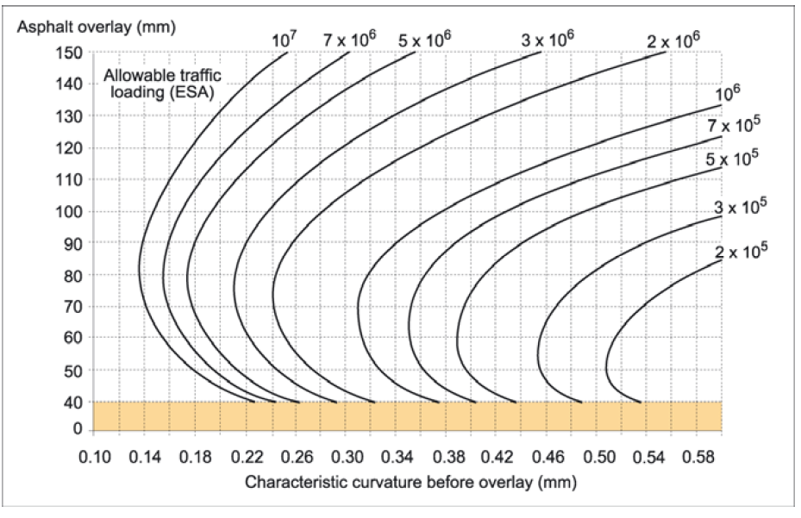
Design Procedure – Asphalt Overlay
Determine thickness required to avoid asphalt fatigue
Two thicknesses can work – very thin <40 mm or above curved line
Example: For 10⁵ ESA design deflection is 1.6 mm
Either AC >88 mm (say 90 mm) or
less than 50 mm (say 40 mm)

Slide 24
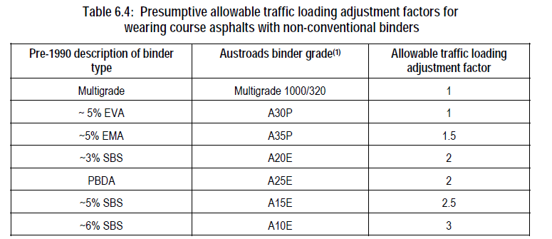
Design Procedure – Asphalt Overlay
Can adjust traffic – and hence overlay thickness for non-standard asphalts (provided resultant overlay is less than 50 mm)

Slide 25
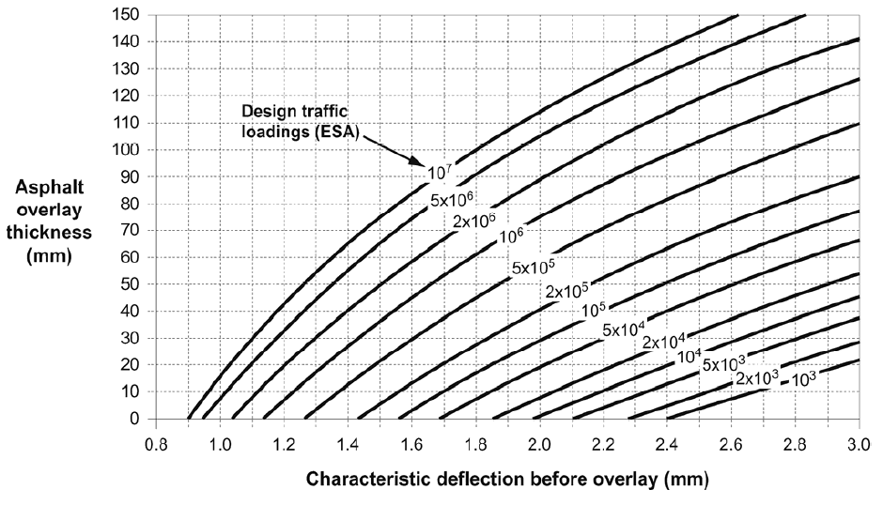
Design Procedure – Asphalt Overlay
Asphalt overlay – thickness required from characteristic deflection
Based on WMAPT of 25° and C320 binder

Slide 26
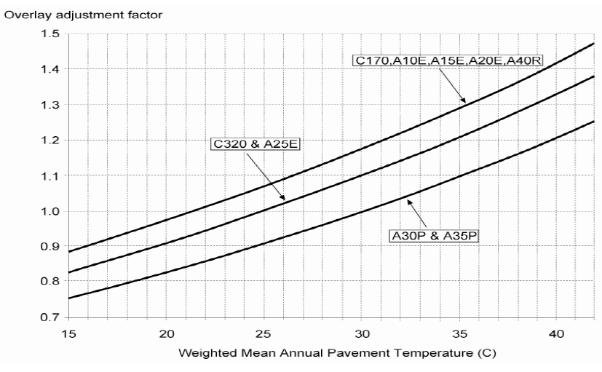
Design Procedure – Asphalt Overlay
Where WMAPT > 25° or lower stiffness binder used adjust overlay

Slide 27
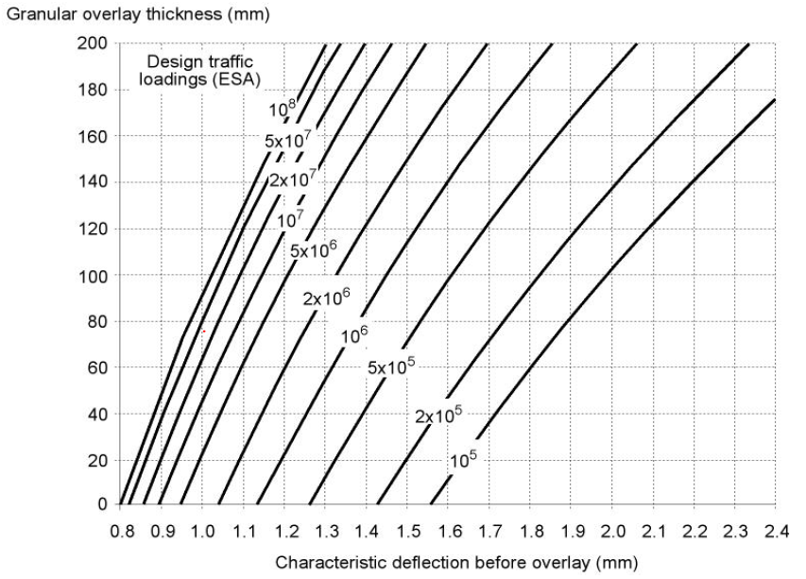
Design Procedure – Granular
Use following chart for granular overlay thickness required
Need 140 mm

Slide 28
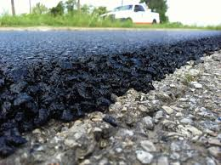
Overlay Design Example
For our example:
  Asphalt overlay
    40 mm ok for curvature and deflection (or 90 mm AC)
    If mill 20 mm existing: need 65 mm for deflection (but this would be an issue for asphalt fatigue and would need 95mm AC for curvature)
  Granular Overlay
    Need 140 mm (but existing kerb and gutter)

Slide 29
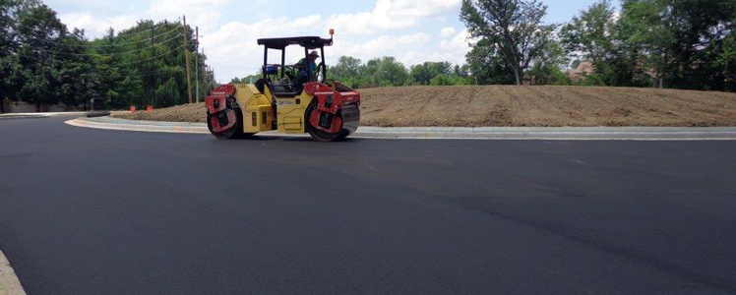
Pavement Overlay Design
THANKS

